Slide 1
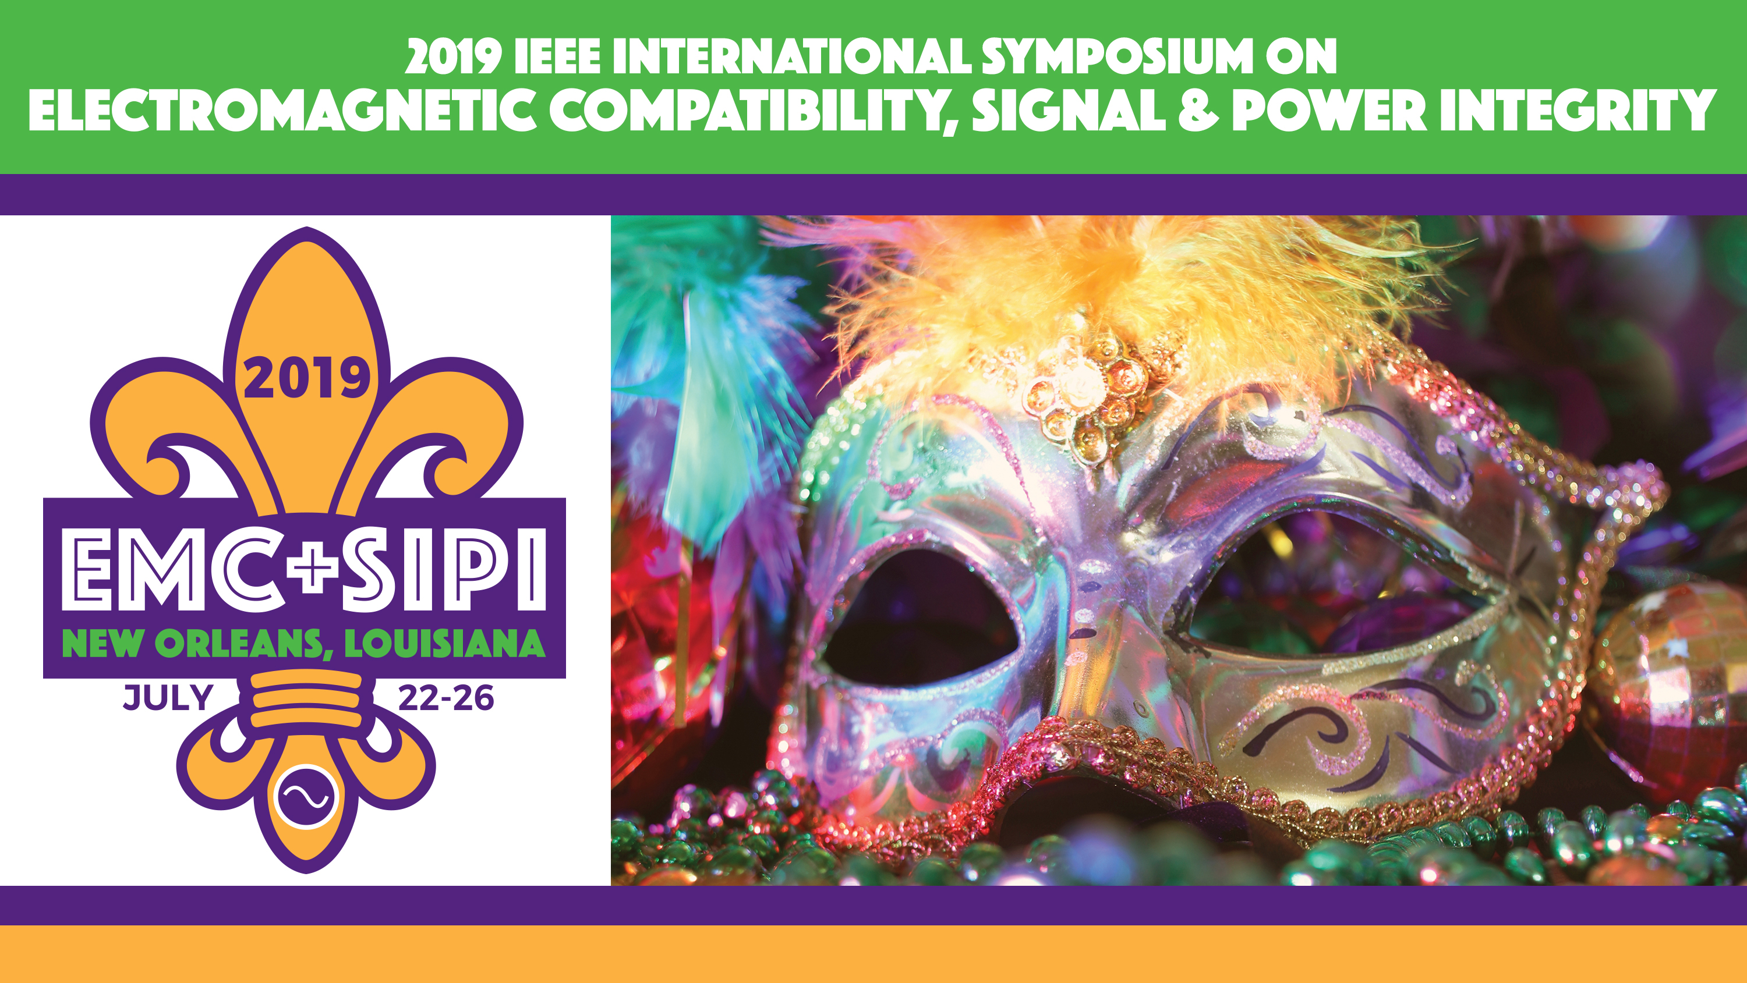

Slide 2
Rock River Valley Chapter
Jamal Shafii, Chapter Chair
Steve Davidson, Chapter Co-Chair
Rockford, IL, USA
Jamalshafii@ieee.org
Steve.daidson@ieee.org

Slide 3
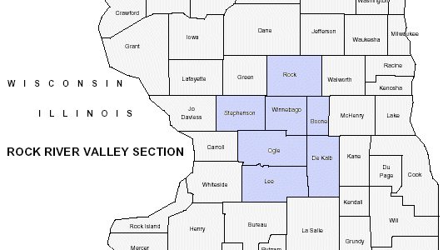
About the Chapter
Serving North Central Illinois and extreme South Central Wisconsin
Founded in June 2007
15 EMC Chapter members
Holding EMC meetings in conjunction with Section meeting
Awarded the most improved chapter award in 2011, 2014, 2017

Slide 4
Regular Meetings
October 25, 2018
  ‒ Speaker: Colin E. Brench
    Principal Engineer at Amphenol High Speed Interconnects
  ‒ Title: Radiated Emissions: Understanding Product and Measurement Antenna Behavior
  ‒ About 40 people attended
  Held at local NTS test house
  April 25, 2019
  ‒ Speaker: Mike Hertz
    Field Applications Engineer with Teledyne LeCroy
  ‒ Title: Measurements and Analysis for Switchmode Design
  ‒ About 30 people attended

Slide 5
Special Event: EMC Seminar
June 11, 2019
Title: EMC Circuit Design for the Real World
Speaker: Dr. Bruce Archambeault
    IEEE EMC Society President
One-day seminar, 4 sessions
About 130 people attended
18 exhibitors

Slide 6
Best Practices
Serving the needs of the local industries and working engineers to further their skills.
Publishing meeting reports in EMC Society magazine
Organized one-day seminars on the 2nd week of June in last 8 years
WebEx meeting (live online webcast)

