Slide 1


Slide 2
IEEE EMC Chapter Chair Training
Caroline Chan
Chapter Coordinator
Caroline.chan.us@ieee.org

Slide 3
Agenda
GDPR – By Susanne Kaule
Young Professionals – Training
  Award Recipients
  YP Rep
Financial Matter
OU Analytics – Members Information
Officer Voting/Reporting and Officer Description
Event promotion and reporting
Senior Member Elevation
PACE
IEEE EMC Benefits (includes IEEE EMC DL Videos: Free to members https://ieeetv.ieee.org/ondemand/emc)
Web Design: IEEE Wordpress
Collabratec
Chapter Reports

Slide 4
He that does good to another does good also to himself.
Seneca (4 BC-65) Roman philosopher and playwright.

Slide 5
Every kind of peaceful cooperation among men is primarily based on mutual trust
Albert Einstein (1879-1955) German-Swiss-U.S. scientist.

Slide 6
GDPR – By Susanne Kaule
What is it? How is it affected us?

Slide 7
Young Professionals
Congratulations to Lin Biao Wang for being the first YP award recipient!
IEEE EMC YP Representative: Louann Devine ieeeypemc@gmail.com
YP Training Slides from the Santa Clara Valley Section:

Slide 8
A Real Story from the IEEE Young Professionals:
from Graduation to a satisfying job
  https://www.ieee.org/societies_communities/geo_activities/sections_congress/2014/sc2014_enhance_embracing_young_professionals.pdf

Slide 9
The best work is accomplished through teamwork
(Member from Santa Clara Valley)

Slide 10
Financial Reporting
Please be sure to close out your 2019 meetings in order to qualify for your Chapter rebate. Bonus for timeliness: All Sections whose reporting (financial, meeting, and officer) is submitted by the third Friday in February, will receive a 10% bonus of the total rebate not including activity bonuses. If the information submitted is not complete or contains errors, and if corrections are not submitted within 60 days of a written request, the 10% bonus will be forfeited. The written request provided by IEEE will clearly state what action is expected, the date by which it must be submitted, and the consequence if not submitted. See the current rebate schedule for a complete explanation of requirements and payment details - A Chapter is required to report and file not less than two (2) technical meetings per year. Changes to its roster of officers need to be submitted in a timely manner using electronic reporting tools provided by MGA <http://vtools.ieee>. A Chapter/Affinity Group may be dissolved if reports are not submitted for three (3) consecutive years.

Slide 11
Chapter Rebate and how to get more $$$
Website: http://www.ieee.org/societies_communities/geo_activities/required_reporting/rebate_schedule.html
A- Chapter rebate: US$200 for each chapter and MUST MEET minimum requirement (see below) by doing the L50 (filled by the Chapter Treasurer). Contact your section on how to do L50 https://www.ieee.org/societies_communities/geo_activities/required_reporting/financial_reporting.html
Bonus for timeliness: All sections whose reporting (financial, meeting, and officer) is submitted by the third Friday in February 2020 (exact date might change, verify with your section), will receive a 10% bonus of the total rebate.
Activity bonus: In an effort to encourage activities at the local level, activity bonuses may be awarded as follows:
  - All chapters or affinity groups reporting six or more meetings shall receive an additional US$75; in the case of a chapter, at least six of the reported meetings shall be in the technical category. To be filled by the Chapter Secretary in L31 meeting reports https://meetings.vtools.ieee.org/main
Section gets: Membership rebate: US$3 for each member, Graduate Student member, Student, or Associate grade member, US$1.50 for each Affiliate, and US$4 for each Senior or Fellow grade member, based on 31 December 2019 statistics.

Slide 12
Get more $$$
B- Angel Funds $600/year to chapter in financial need. Refer to http://www.emcs.org/chapters/haislmaier.html
C – Chapter Awards: http://www.emcs.org/awards_main.html
Chapter-of-the-Year Award ($250)
Most Improved Chapter Award ($250)
Chapter Founder Award (No monetary fund but recognition)
Tip: start organizing the year before to hit your goal
D- Fundraising/mini symposium: contact Janet O’Neil (j.n.oneil@ieee.org) for any advice on how to organize.
Tip: make it annual to keep consistency, else hard to restart. Organize a technical talk + vendors/exhibit

Slide 13
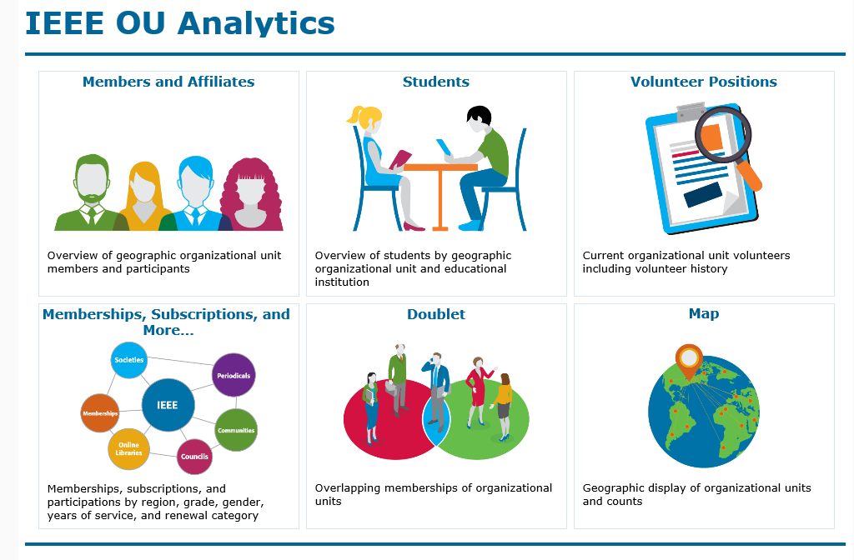
How to Use IEEE OU Analytics
More data in the OU analytics with statistics such as gender, multiple IEEE member, student members information, etc
OU Analytics Webinar Training Available: To receive customized or personalized training for a better understanding of how to use OU Analytics, please email ouanalytics@ieee.org or tad-chap-dev@ieee.org. http:www.ieee/org/ouanalytics

Slide 14
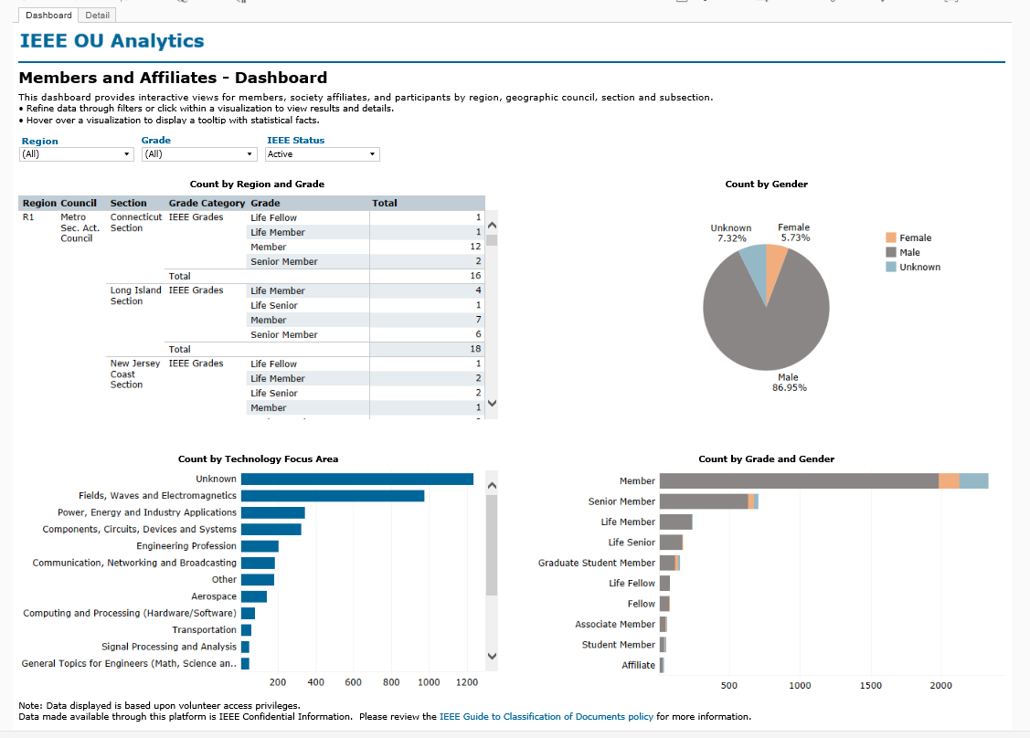
IEEE OU Analytics
Member’s details (name, email, etc)

Slide 15
Officer Voting/Reporting and Officer Description
Elect your officers yearly
Report your officer at vtools as soon as they are elected

Slide 16
Event promotion and reporting
Use vtools and IEEE app to login your event.
  IEEE app: https://app.ieee.org/
  Follow the steps in the file to create, search and manage your event.
Use social media that you can schedule your post and post in different social medias at the same time
  https://buffer.com/ (there is a free basic plan, scroll down the window on their website under pricing)
  or check out other options: https://influencermarketinghub.com/social-media-posting-scheduling-tools/

Slide 17
Senior Member Elevation
Did you know that once a member is elevation to Senior Member, he/she will tend to remain in the Society.
Who review the applications and how to apply is provided by the Santa Clara Valley Section

Slide 18
What is PACE?
IEEE EMC PACE Officer : Kimball Williams k.williams@ieee.org.
Professional Activities Committees for Engineers
A network of IEEE volunteers and committees organized at the section and chapter levels with support from Regions and IEEE-USA.
BUT, this is not just for USA members but everyone needs professional development!

Slide 19
PACE Objectives
(Professional Activities Committees for Engineers)
PACE promotes:
  The professional interests of the U.S. members
  The professional activities of Sections, Chapters, and Student Branches
  A mechanism for communication of members' views on their professional needs

Slide 20
Five PACE Topics
Government Activities
Career and Employment Enhancement Activities
Pre-university (K-12 STEM) Activities
Student Professional Awareness Activities
Technical Policy Activities

Slide 21
Other IEEE Benefits
Many benefits but here are some examples.

Slide 22
Manage Your Research Data
Other IEEE Membership Benefits
IEEE is proud to introduce you to IEEE DataPort™, a valuable, easily accessible data platform that can significantly enhance your research efforts. Upload and store standard or open-access datasets for free with the option to link your paper submission.
Further benefits include:
2TB of storage for datasets, scripts, visualizations, related documentation
Provides Digital Object Identifier (DOI)
Can support and facilitate Data Challenges
And more
As a valued IEEE member, you are currently entitled to a FREE automatic subscription to IEEE DataPort, which provides access to all IEEE DataPort datasets. Log in using your IEEE Account and start realizing the benefits of IEEE DataPort.
> Try IEEE DataPort

Slide 23
IEEE.ORG Email address (under gmail)
Did you know that you can set up your own @ieee.org email address? After you create and claim your alias, activate your IEEE-branded Gmail account or set up mail forwarding services. In addition, you will have access to GoogleDrive, advertisement-free Gmail, 30 gigabytes of shared storage, and a 99.9% up-time guaranteed by Google.
> Claim your alias

Slide 24
Monthly Audio Book
Free Audio Book Rewarding Your Employees in Tight Economic Times - Vol. 2: Some Additional Techniques July’s free audio book for members exams the age-old dilemma every manager faces; how to reward key employees on a tight budget. In this second volume, Rewarding Your Employees in Tight Salary Times—Volume 2: Some Additional Techniques, author Harry T. Roman offers strategies, tips and techniques for rewarding key people. > Download the Free Audio Book

Slide 25
Benefits
  Leadership/Management Role/Do something you don’t have the opportunity to do it at work/school
  Good Young Professionals List so that YP volunteers can go to different positions by nomination from other people that might not know this person http://yp.ieee.org/volunteers/good-young-professionals-list/
  Hundreds of Volunteer Roles among IEEE (not just EMC)
  Technical/Professional presentation/publication (https://ieeetv.ieee.org/ondemand/emc some free lecturers for EMC Members and fees for non EMC members)
  Job and Internship Opportunities (IEEE Collabratec https://ieee-collabratec.ieee.org/)
  Job Fair (tag along with local events)
  Networking with people in the same field, professional development
    To be exposed to new technology as well as established tech
  Discount on Conference fees, symposium proceedings
  Increase self-esteem
  Non technical benefits like insurance

Slide 26
Benefits
  Scholarship (Scholarship Grant and Fellow (might be specific to society) and also ask your section if they offer any particular ones for local Universities)
  IEEE Competition (EMC for Student Hardware, contact ESAC)
  IEEE Mentor Center:
  http://www.ieee.org/membership_services/membership/mentoring/index.html
  Resume lab: http://www.ieee.org/membership_services/membership/resumelab.html
    Develop your resume or curriculum vitae (CV)
    Letters (cover letter, thank you letter, etc)
    Portfolio of work
    Skills assessment
    Mock Interview (you can record yourself)
    Video Resume to potential employers

Slide 27
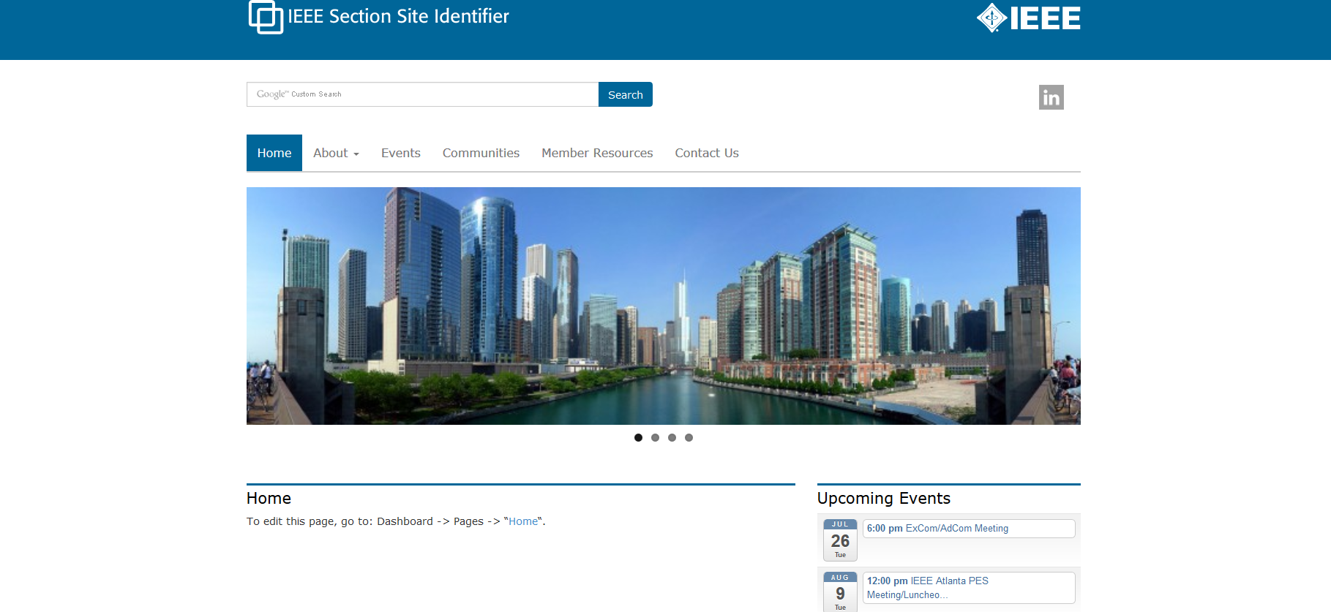
Wordpress (1 of 4)
Template and Host:
Based on IEEE Template, no programming experience necessary
This is what the template will look like: http://sites.ieee.org/section-template/
Request the template and for IEEE host: http://sites.ieee.org/hosting/wordpress-hosting/
(you can add other users later once you become the Admin)
If you haven't heard from IEEE within a week, please contact Khanh Luu k.n.luu@ieee.org
Khanh is the Sr. Information Management Analyst of the IEEE Member and Geographic Activities
Department (MGA)

Slide 28
Wordpress (2 of 4)
Officers updates on Wordpress:
Once the website is up (with login):
http://sites.ieee.org/wnv-emcs/about-ieee/executive-committee/
and
http://sites.ieee.org/wnv-emcs/communities/
are automatically updated for you. To update the officer information use http://officers.vtools.ieee.org/.
To update the communities page, please contact Khanh Luu k.n.luu@ieee.org
Website Updates:
Once you have the login, make the updates by doing to
dashboard-> pages-> select the page you want to edit->type the
information and click on UPDATE (not preview since the "preview" function is not working).
Luckily if you do not like what you just updated, you can always choose the previous revision and go back
to it.

Slide 29
Wordpress (3 of 4)
Meeting calendar updates:
Note that for the calendar, you can go get your URL meeting from the L31
https://meetings.vtools.ieee.org/main
(go to "schedule meeting) to update the RSS feeds. Please take a look on the documents provided in the
Ppt attachment for Wordpress Feeds for step by step instruction. It is easier for the chapter to set and
also a push for the chapter to input their incoming meeting early and hopefully complete the L31 early also.
You can change the "IEEE section identifier" (left corner) by going here
(and you can put the EMC society logo or add your own chapter one) once you have the login and change
the highlight part
of the link to your particular chapter website link (replace “wnv-emcs” with your chapter name)
http://sites.ieee.org/wnv-emcs/wp-admin/customize.php?return=%2Fwnv-emcs%2
Fwp-admin%2F&autofocus%5Bcontrol%5D=header_image

Slide 30
Wordpress (4 of 4)
Download IEEE Sites theme tutorial file at
https://drive.google.com/open?id=0B_i1MnQg-aYveXFtODFheFhXR1k&authuser=0.
You also check out the WordPress tutorials presented by Lance McBride and Ed Perkins at:
Session 1 – Fundamentals – Basic WordPress interface and structure, Templates, Calendar
http://research.microsoft.com/apps/video/default.aspx?id=242111
Session 2 – Intermediate - Metatags, Plugins, vTools Calendar, Forms, Surveys,
Promo Images, Redirections, ecommerce)
http://research.microsoft.com/apps/video/default.aspx?id=242109

Slide 31
What’s new with the EMC Society
IoT participation along with other IEEE Societies (collaboration/have a stake): EMC Contributor Mike Violette (DC.Northern VA Chapter Chair)
IEEE EMC Women-In-Engineering Rep (WIE) -> Susanna Kaule
A Practical Paper Journal is being discussed as a separate electronic only and/or print publication. This would include application oriented papers or papers presenting case-studies.
Calling for Participation into the TCs: (Technical Committees) and PACE-IEEE USA (Professional Activities Committees for Engineer BUT it is not just about USA). For more PACE information, contact Kimball Williams (k.Williams@ieee.org) https://www.ieeeusa.org/volunteers/pace/
IEEE USA: free e-book every quarter: check your email and resend to your members
Student Liaison: TBD (looking for candidates, contact Vignesh@ieee.org)
Young Professionals (Starting Term 2018): Louann Devine ieeeypemc@gmail.com

Slide 32
Who will you work with and How
Note: This table is NOT a 1-1 answer
WHO | How | Link
Section
YPs (Society AND Affinity Group) Students/Student Branch Chapters (SBC) | Presentation (with food), Social Activities | Be a Speaker at the SBC/YP/WIE session Congress. R8 (once every 2 years, summer), R9 (once every 2 years), R10 (every year, summer), R6 (once a year at Las Vegas before CES in January) Get involved with IEEE STEP (Student Transition & Elevation Partnership) such as be a panelist at a College through their Student Branch. https://www.ieee.org/societies_communities/geo_activities/volunteer_recruitment_toolkit.html
Sister Societies | IEEE TV | https://ieeetv.ieee.org/
EMC Associations, Universities, City Council | Professors, Open House, presentations (with food) | webinar series – Young Professionals https://www.ieee.org/membership_services/membership/young_professionals/events/index.html
Active members, Section | eNotice (vtools) = Newletter sent to all your members (automatically add new members) | http://www.ieee.org/about/volunteers/enotice/enotice_index.html
 | Collaboractec for volunteers | IEEE Collaboratec https://ieee-collabratec.ieee.org/),
Distinguished Lecturer , engage successful people in the industry |  | http://www.emcs.org/dl-main.html
EMC Society |  | Depends on the need, contact appropriate officer
Technical Advisory Committee |  | http://www.emcs.org/committees/tac/
Technical or professional Activities | Angel Funds (for needy chapters) | http://www.emcs.org/chapters/haislmaier.html
Companies (EMC Test labs, local industry) | Sponsorship/fundraising/mini symposium | For food during meetings or annual sponsorship and recognize them,

Slide 33
Example of eNotice
Lots of valuable information inside for volunteers and Awards

Slide 34

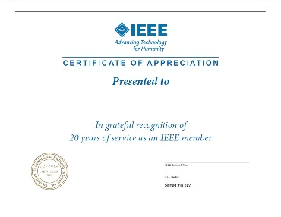
Retain and Rejuvenate
  Membership Deactivation/Arrears (SAMIEEE using vtools up to May 25th/ OU Analytics starting now)
  Associates to Member: http://www.ieeer8.org/category/membership-development/
  Senior Member Elevation IEEE Senior Elevation
  Membership Discount/ referral
  (IEEE Membership Referral and Discount (new Members to IEEE))
  Survey
  Loyalty Pins (recognize new and long time members) IEEE Loyalty Pin Program
  Certificate of Recognition and Award (individual, section, and companies, friend of IEEE (does not have to be a member))
  MGA Award and Recognition Program
  IEEE USA Award Program (Professionalism and Technical awards)
  Title (not volunteer but Webmaster or Director of Social Media, title provides the importance of the position and Recognition)
  Sponsor a potential (active) volunteer to an event
  One-day seminar (with or without exhibitor, fees or no fees for admission) – meet new members/good speakers
  Mentoring
  Social media/Translate material in the local language
  Change of venues and presentation style (museum, outdoor, etc)

Slide 35
Collabratec
  https://ieee-collabratec.ieee.org/
  What is Collabratec?
  The IEEE Collabratec Branding and Communications Toolkit is a marketing resource for promotions and communications in connection with IEEE Collabratec. This toolkit explains how to use IEEE Collabratec brand elements and offers resources for creating strong and consistent communications pieces while supporting the IEEE brand.
Targeted at both IEEE members and non-members, including authors, researchers, and volunteers, IEEE Collabratec helps users:
Connect with global technology professionals by location, technical interests, or career pursuits
Access research and collaborative authoring tools
Establish a professional identity to showcase key accomplishments
IEEE Collabratec also helps IEEE volunteers:
Build and manage their IEEE volunteer network
Build communities and engage technology professionals in real time
IEEE Collabratec competitively positions IEEE for the future of publishing, professional networking, and career development. IEEE Collabratec brings together IEEE and non-IEEE individuals – whether they are authors, publishers, IEEE members, or other technical professionals who have similar interests – through an integrated online community, facilitating collaboration and connectivity.
All in one centralized hub, IEEE Collabratec offers these major features:
Online communities
Author and researcher tools
Career development networking opportunities

Slide 36
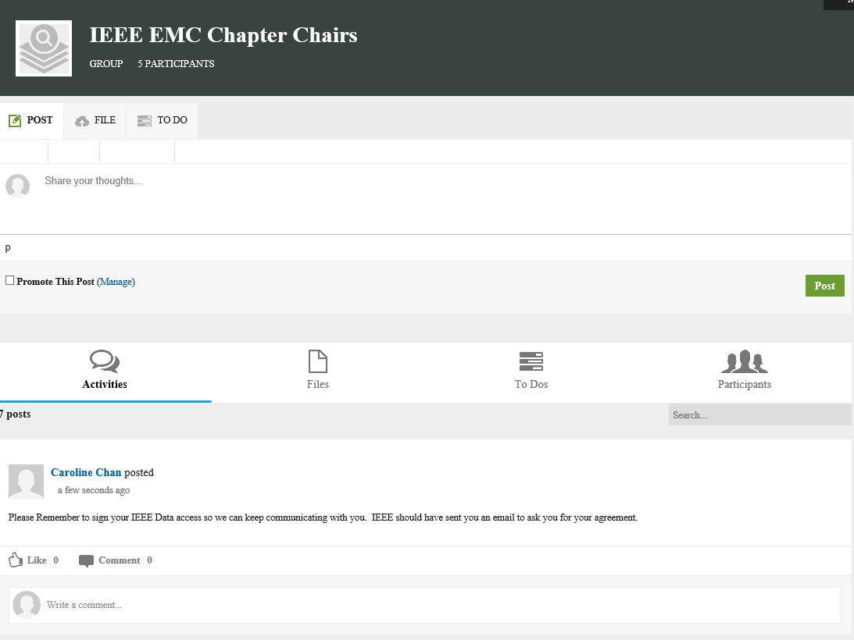
Collaboratec
  Used as a working forum for a small group. Does NOT work for the public.
  You can create a group, upload a document for review.

Slide 37
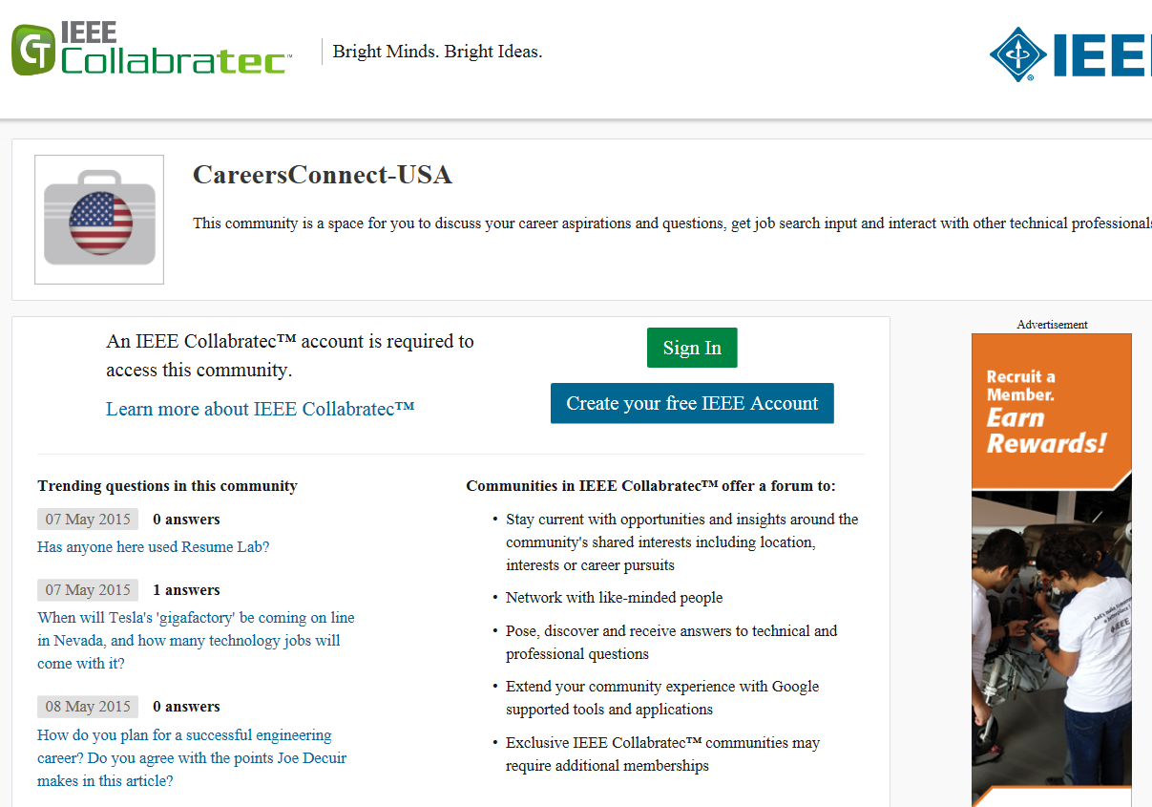
Collaboratec

Slide 38
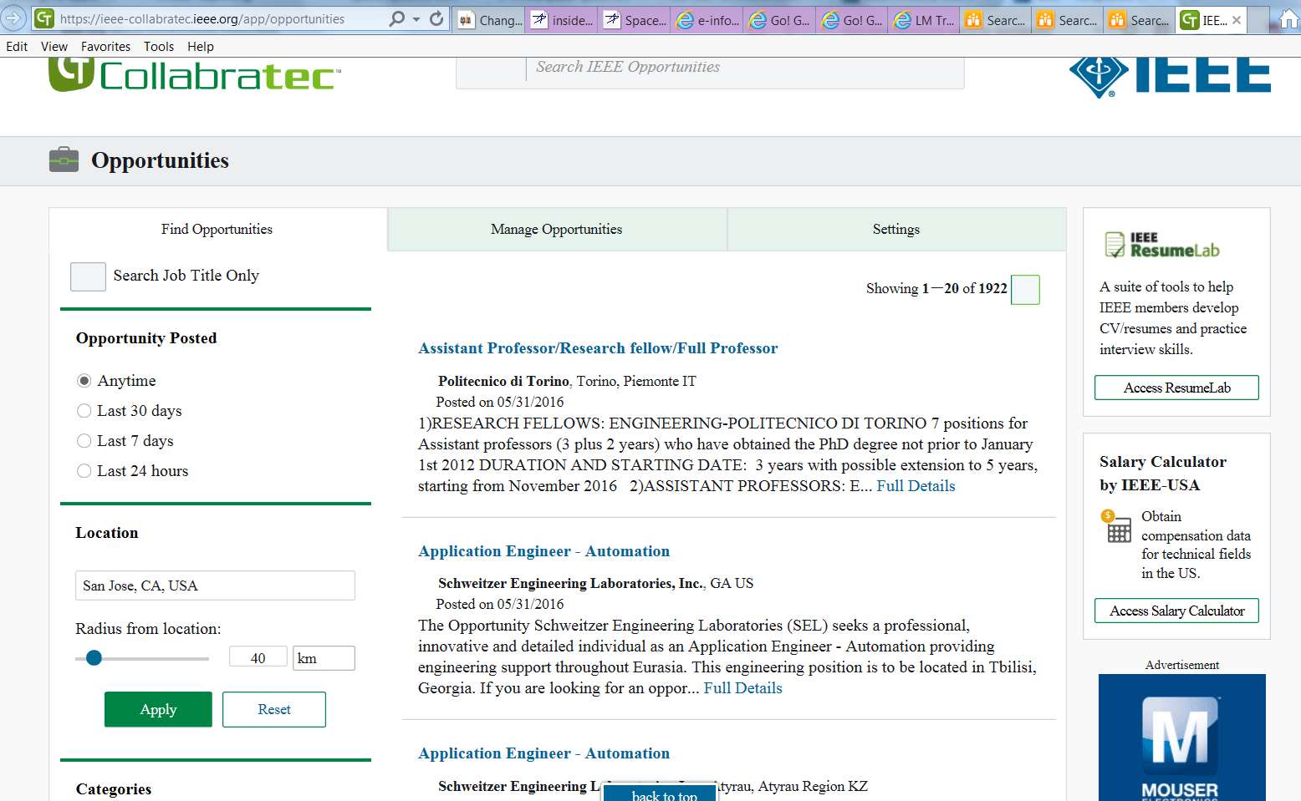
Collaboratec: Job Opportunities

Slide 39

Questions?
Thank you

